Slide 1
Will AI take my job as Artist
By: Abigail Appiagyei

Slide 2
What is Artist?
A artist can typically be many these things but the traditional way we think of a artist is some who either paints or draws
Examples of some famous artists are:
Leonardo Divinchi
Picasso
Vincent Van Gogh

Slide 3

How has this job changed?
Over the years as technology has been expanding and getting more advanced, so has the way we have been seeing and displaying art. We are now seeing more photos on media platforms

Slide 4
What is AI changing specifically?
We now see photos being made on social media or photoshop using the photoshop app on mac and window computers

Slide 5
The future of a Artist

Slide 6
What do we see in the future for Artists?
For artists in the future I see more artists taking there art and using it on electronics or AI using copies of pictures to make it look like a real painting

Slide 7
Big concept
Bring the attention of your audience over a key concept using icons or illustrations

Slide 8
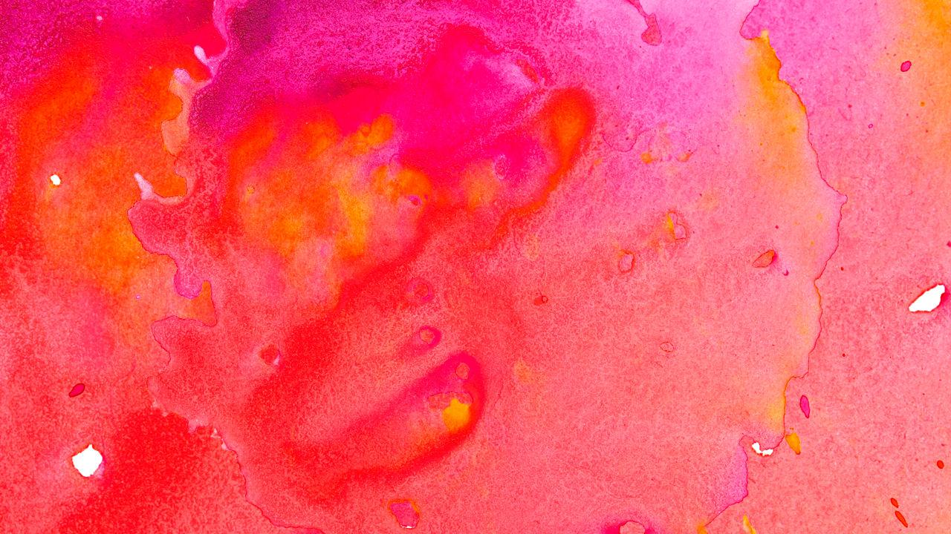
Citations
https://www.bbvaopenmind.com/en/articles/artificial-intelligence-and-the-arts-toward-computational-creativity/
https://www.forbes.com/sites/theyec/2018/07/06/do-you-fear-artificial-intelligence-will-take-your-job/#13d0353111aa
😉

